Slide 1
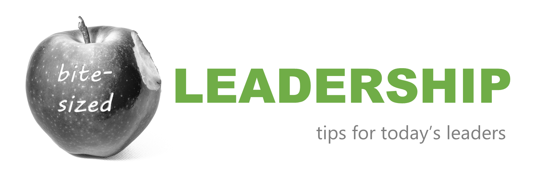
Performance Assessments
Source: https://www.pexels.com/@laura-iglesias-43382929/
Notes:
To those of you in the room with me and those joining online… Welcome to the a new learning series we have titled “Bite-Sized Leadership – Tips for Today’s Leaders.”
Since all of you will be soon working on Performance Assessments, we thought appropriate to start with that topic.
For those of you I haven’t met, my name is __________ and I serve on the HR team as ________________.
I’d like to also acknowledge my colleagues in the room…

Slide 2
Learning path
Why a Performance Review?
The process
Watch out for those biases
Key dates for 2024 Performance Reviews @ UWGB
What’s changing for 2025 and beyond?
Additional resources to assist you
Source: https://www.pexels.com/photo/person-standing-on-arrow-1745766/
Notes:
Someone once told me that next to terminating someone’s employment, performance reviews are the second most dreaded process that HR facilitates.
I don’t know if this is true, but I agree that the process can be challenging…. But hopefully you will either learn a few things or refresh your memory on techniques to make the process better.
For our session today, we will follow this learning path…
We will ask the question: “why bother with Performance Reviews?”
We will take a quick look at the process we follow at UWGB
We will learn about potential biases that may creep into our evaluations
We’ll review key dates for this years performance assessment process
Finally, we’ll take a sneak peek at what’s coming this year in preparation for the next

Slide 3
Why a performance review?
Source: https://www.pexels.com/photo/oval-brown-wooden-framed-hanging-mirror-1528975/
Notes:
The idea here is that Performance reviews ground and calibrate our self-perception which could only provide part of the story or could be misleading.
Having a supervisor assessment will ensure that employee performance aligns with organizational objectives and accepted behaviors.

Slide 4
Why a performance review?
Source: https://www.pexels.com/photo/judgement-scale-and-gavel-in-judge-office-5669602/
Notes:
When ongoing performance or policy violation issues are not documented in a performance review and those events result in disciplinary action or termination of employment, it could create a liability for the university.

Slide 5
The process
[1] Goal setting
[2] Documenting performance
[3] One-on-ones
[4] Annual review
Notes:
The process starts with
….you setting goals for your direct reports,
… you then document performance events throughout the year
… you and your team members meet on a regular basis to chat about goals, expectations, etc.
… You arrive at the annual review
We’ll take a brief look at each step now…

Slide 6
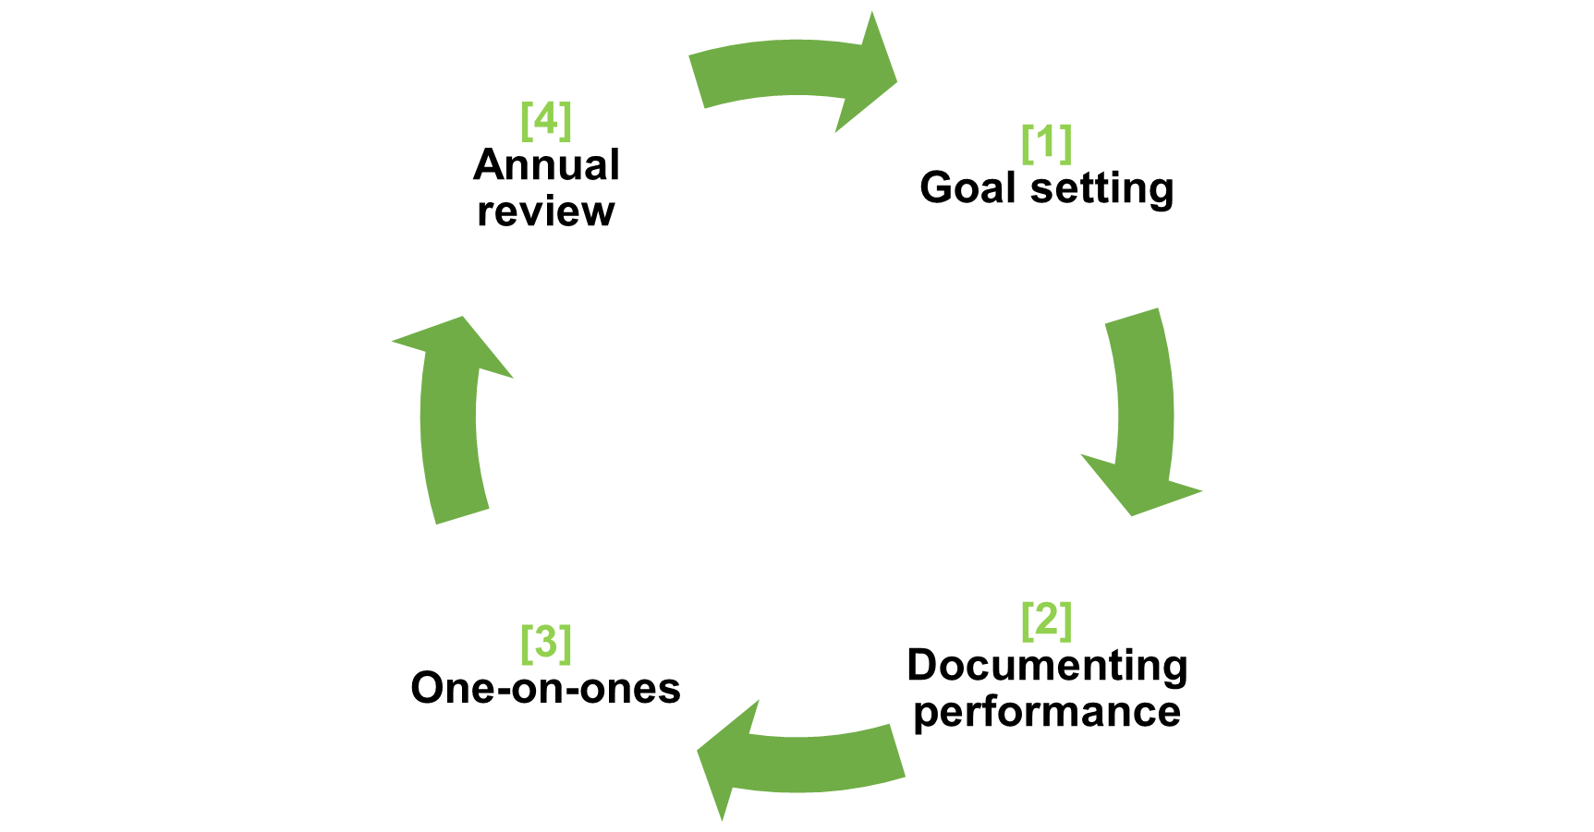
Goal setting
Specific
Measurable
Achievable
Relevant
Time-bound
Notes:
When setting goals for your team members, we highly recommend you do so using the SMART acronym which stands for
Specific
Measurable
Achievable
Relevant
Time-bound

Slide 7
Goal setting
I want to get in better shape by running more this year.
Notes:
New Year’s resolutions could be vague like this one…

Slide 8
Goal setting
I will get in better shape by running. My objective is to run 5 kilometers without stopping. I will start by running 1/2 kilometer and gradually increase the distance by 0.5 kilometers each week. Improving my physical fitness will help me feel healthier and more energetic. I will achieve this goal by March 31, 2025
Notes:
SMART New Year’s resolutions

Slide 9
Documenting
Performance journal
Project & task tracking
One-on-one meeting notes
Email folders
Check-in’s with employees’ main customers
Notes:
A year is a long time to remember everything that your direct reports have accomplished. Relying on pure memory is obviously not feasible. These are some of the tools you may use to ensure all or most employee performance-related events are considered in your review.
Journal. Whether you keep in in OneNote, notes in MS Outlook, MS Word notes, etc. Saving thoughts or comments about employees is a great
Task tracking. In your workload meetings you may ask employees to report on status of various projects.
One-on-One meeting notes. These meetings provide a great opportunity to give feedback throughout the year. Notes on the feedback provided are beneficial for the annual review
Email folders. Save notes, emails, feedback from customers in a folder.
360 Feedback from Customers. Ensure that feedback is weighed fairly considering

Slide 10
One-on-Ones*
Set/Review goals for the year
Tools, obstacles to achieve goals
Two-way feedback
Career objectives
* A.K.A. Stay Interviews, Check-Ins
Notes:
Not to be confused with “workload meetings” or regular meetings to talk about projects and tasks, these meetings are focused on the employee, their career, their annual goals, obstacles they face to achieve those goals, tools/training needed to achieve goals, two-way feedback, career aspirations, etc.
They may also be referred to as “stay interviews,” “check-ins,” etc.

Slide 11
Annual Review
Update performance assessment form by adding responsibilities from position description.
Send performance assessment form to employee requesting self-assessment
Gather information from journals, notes and internal customers
Notes:
This is a quick outline of the Performance Assessment process at UWGB.

Slide 12
Annual Review
Draft performance review
Meet with each employee to discuss your assessment
Use DocuSign to request signature from employee and for your own signature
Submit to HR (through DocuSign)
Notes:
This is a quick outline of the Performance Assessment process at UWGB.

Slide 13
Annual Review
The meeting
Prepare, prepare, prepare
Give employees time to respond
Be ok with criticism
Choose a quiet place to limit interruptions
Don’t waste time in the meeting – keep on topic
Focus on job tasks and objective evidence.
Notes:
This is a quick outline of the Performance Assessment process at UWGB.

Slide 14
“performance assessments are a continuous process not a once-a-year event”
Source: a Wise HR Professional who prefers to live in anonymity
Notes:
I know that we all know this, but let’s read it all together.

Slide 15
Watch out for those biases
Notes:
Biases are errors in judgment that occur when supervisors allow their conscious or unconscious prejudices to affect their assessment of an employee's performance. These biases can lead to unfair evaluations

Slide 16
Contrast
Rather than measuring performance against the standard, you measure the performance of an employee against the performance of another employee.
Source: https://www.pexels.com/photo/parents-measuring-their-child-s-height-7456803/

Slide 17
Halo
You rate an employee highly in all areas because of one thing they do really well

Slide 18
Horn
You rate an employee as a poor performer because of one thing they don’t do well

Slide 19
Leniency
You rate everyone high ratings to avoid conflict

Slide 20
Severity
You rate everyone lower than their performance warrants in an effort to inspire average employees to improve their performance.

Slide 21
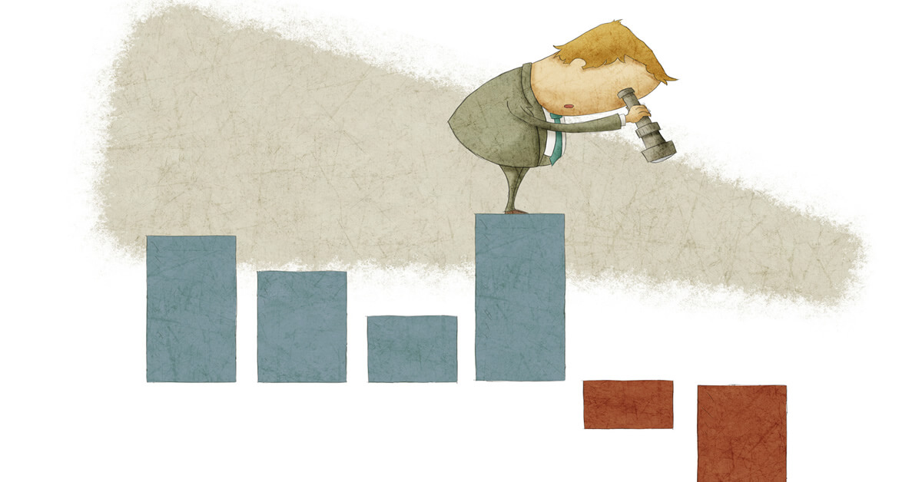
Recency
You rate performance for an employee based on the most recent behavior.

Slide 22
Eliminating biases
Know the standard or target performance for each position
Document performance events throughout the year
Calibrate your assessment
Know what each rating means
Weigh feedback from peers/customers fairly.
If you supervise team leaders, consider calibration sessions to discuss and align their ratings
Practice continuous feedback during one-on-one sessions
Notes:
We will look at one of these tools… “know what each rating means”

Slide 23
The ratings
Family Doctor
General Surgeon
Neurosurgeon
Dr. Bartolomé Oliver
Does Not Meet Expectations
Partially Meets Expectations
Meets Expectations
Exceeds Expectations
Notes:
Imagine you need to undergo a low-medium risk brain surgery… that’s the job expectation and goal.
DNME would feel like having a family doctor operate your brain. This means that in all items of the job description, this individual will not meet the minimum requirements for the job. They may know how to stich a wound, prescribe medication…
PME would be like asking a general surgeon to operate on your brain. This professional is trained on many types of surgeries, will be able to operate, but will not know how to address the brain. This person would not meet your expectations of a successful brain surgery
Hiring a neurosurgeon would be the appropriate way to go. This individual has been trained on how to operate the brain, knows what to look for and could complete the surgery well. That’s meets expectations.
Dr. Bartolome Oliver is a Spanish neurosurgeon who is considered one of the best in his field. They only bring the most complex and riskiest of operations. Completing a more common surgery like yours would probably feel like he can do it in his sleep. This is Exceeds expectations.

Slide 24
Avoid writing about…
personal characteristics
Avoid mentioning age, race, gender, religion, disability, or any other protected characteristic. For example, saying "Kevin doesn't have the energy level anymore" could be seen as age discrimination.

Slide 25
Avoid writing about…
subjective terms
Words like "attitude," "lazy," or "unmotivated" are vague and can be interpreted as personal attacks. Instead, focus on specific behaviors and outcomes.
Notes:
DON’T SAY: “ Word processing of documents is unacceptable”
SAY: “Errors were found in over 40% of the documents produced over the evaluation period”
DON’T SAY: “You are unprofessional”
SAY: “We have received three complaints from customers not getting called back in the last month”

Slide 26
Avoid writing about…
medical information
Do not reference an employee's medical conditions or health issues. This can violate privacy laws and be seen as discriminatory

Slide 27
Avoid writing about…
personal life
Comments about an employee's personal life, such as family issues or lifestyle choices, are inappropriate and irrelevant to job performance
Notes:
DON’T SAY:
“Since your divorce, your customer service has declined”
SAY:
“Since the summer, we have received a 50% increase in the number of complaints from your customers.”

Slide 28
Avoid writing about…
absolute statements
Avoid using absolutes like "always" or "never," as they can be easily disputed and may not accurately reflect the employee's performance

Slide 29
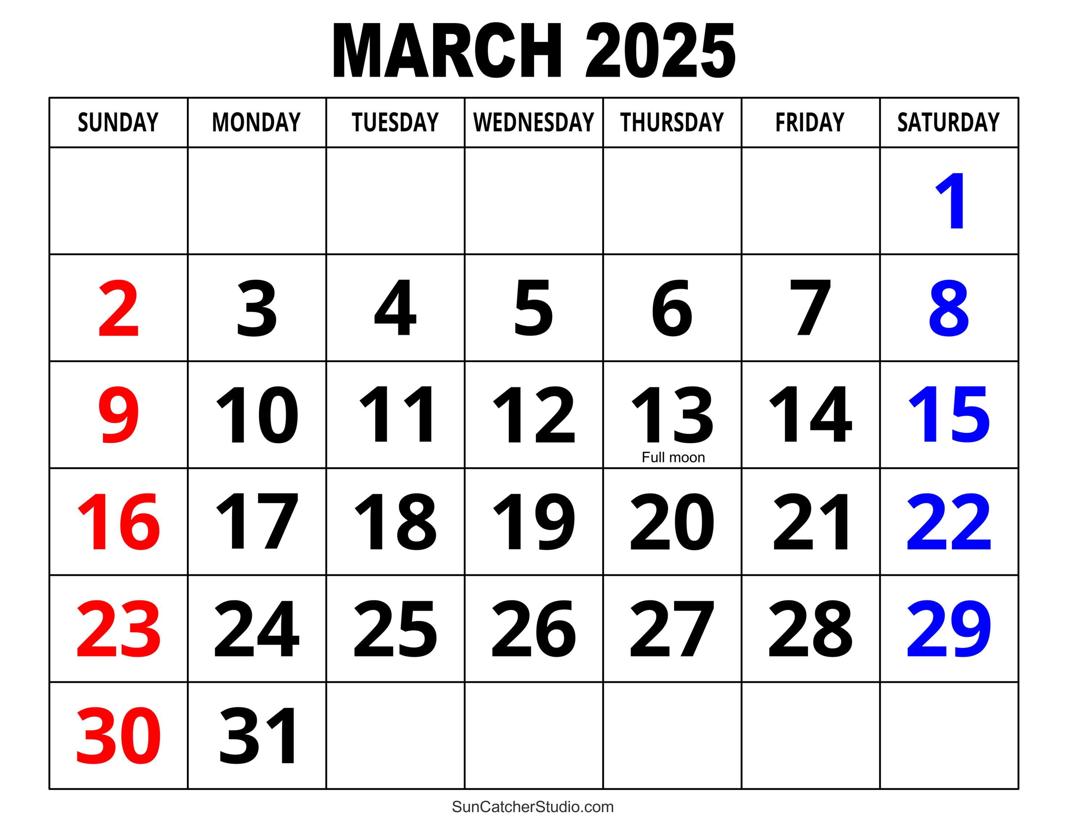
Recommended Key Dates
No later than January 20, 2025
Supervisors share Performance Review form with employees
By February 7, 2025
Employees complete self-assessment
By February 21, 2025
Supervisor completes performance review on each employee
Notes:
In order for all of us to meet the deadline of March 21, we strongly recommend this timeline for your assessment processes.

Slide 30
Recommended Key Dates
By March 7, 2025
Supervisors complete one-on-one meetings with employees
By March 14, 2025
Performance reviews e-signed using DocuSign
March 21, 2025
Performance reviews due to HR via DocuSign

Slide 31
Exceptions to annual reviews
Annual performance evaluations are not required for individuals who have had a 6-month evaluation on or after July 1, 2024, or for new employees hired since this date.

Slide 32
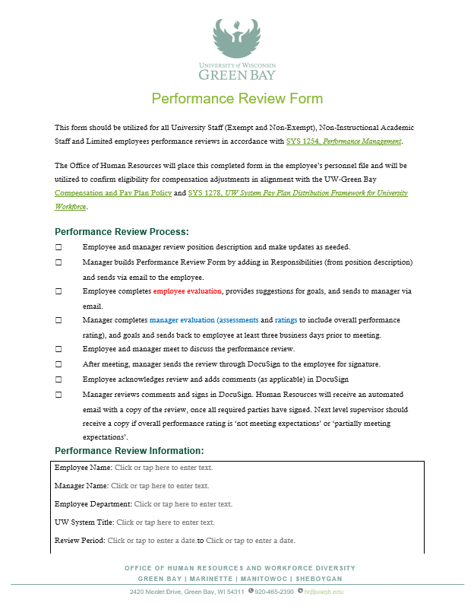
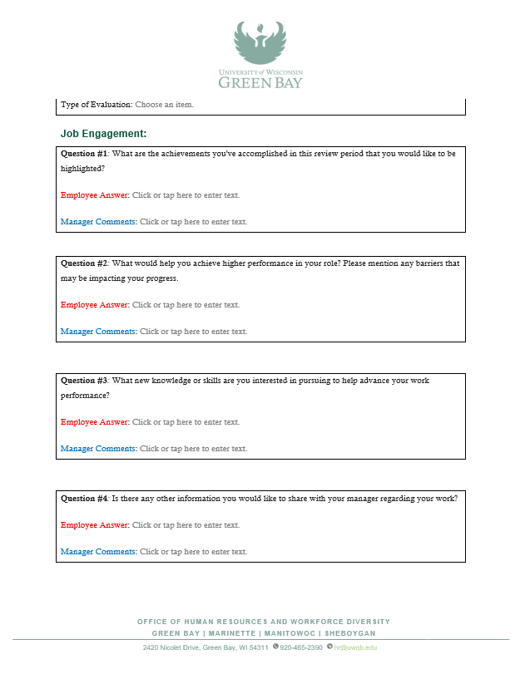
The form
https://www.uwgb.edu/UWGBCMS/media/hr/PerformanceReviewNonInstructional.docx

Slide 33
Signing the form
https://app.docusign.com/home
Performance-Evaluation-DocuSign-Instructions.pdf

Slide 34
Changes in 2025 and beyond…
When? | What?
2025 | Performance Assessment process aligns with the fiscal year Next annual review for FY 2025-2026 in Summer 2026
Summer 2025 | Transition to Workday Setup of Performance Assessment form

Slide 35
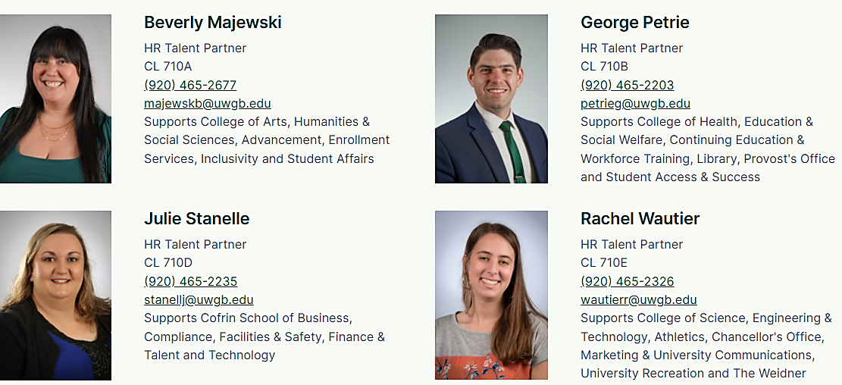
Additional Resources
Notes:
Whether you have questions about the process….
Want someone to assess you on how to write a particular piece of feedback in your performance assessment…
Etc., your HR Talent Partners would be glad to assist you.

Slide 36
Notes:
Any additional questions?

